Slide 1
How to Start a NGO MIS Software System
Presented By G M Mortoza Ahmed
IDB IT Scholarship Project
Trainee ID:1243288
BATCH ID:J2EE/CSSL-M/37/01
Email: mortozafsti@gmail.com
Under Supervision Of
Md. Rajaul Islam
Instructor (J2EE), IDB-BISEW.

Slide 2
What is NGo
A non-governmental organization (NGO) is any non-profit, voluntary citizens' group which is organized on a local, national or international level.
A non-governmental organization (NGO) is a citizen-based association that operates independently of government, usually to deliver resources or serve some social or political purpose.

Slide 3
Advantage of this Ngo’s
Innovative approaches and, if necessary, to take risks.
Flexible in adapting to local situations and responding to local needs
Good rapport with people and can render micro-assistance to very poor people
Ability to communicate at all levels, from the neighborhood to the top levels of government.
Recruit both experts and highly motivated staff

Slide 4
Features of this Ngo’s
Registration and Login Form.
Add User and Member.
Loan wise collection.
Daily basis deposit 10 tk.
Member Wise Daily Collection.
Monthly and Yearly Profit/Loss.

Slide 5
Under Developing Feature Details With Sample
Deposit details with Customer.
Withdraw Loan Via User With Admin.
Loan Summary of Individual Customer.
Given Loan Process.
Loan wise collection.
Daily basis deposit 10 tk.
Member Wise Daily Collection.
Monthly and Yearly Profit/Loss.

Slide 6
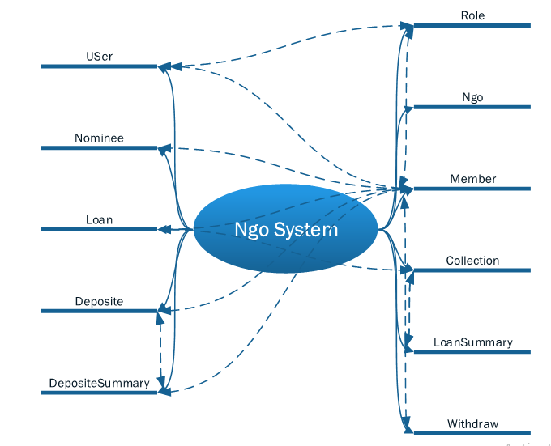
Brainstorming Diagram

Slide 7
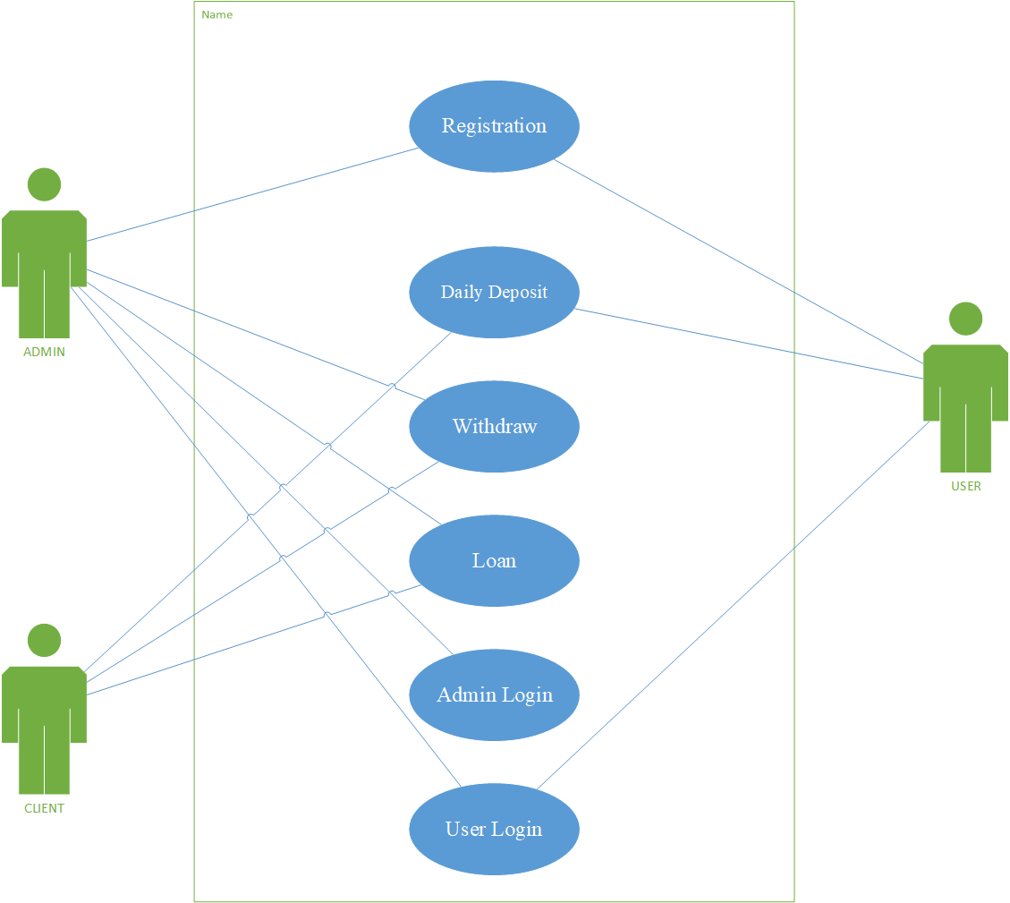
Use Case Diagram

Slide 8
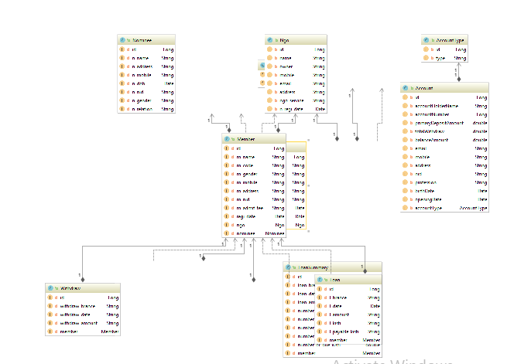
Class Diagram

Slide 9
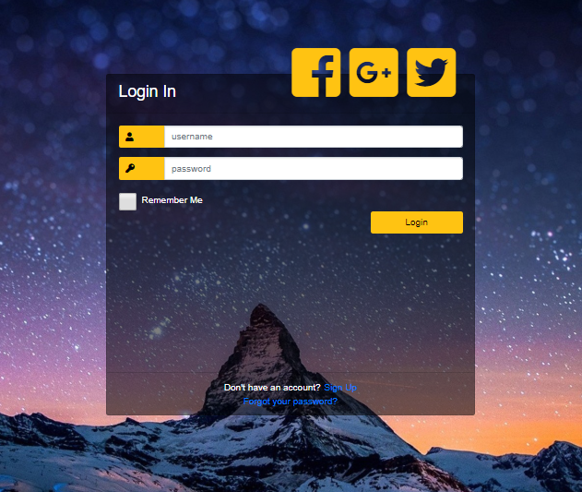
Graphical Interface for Login Admin, Staff and member

Slide 10
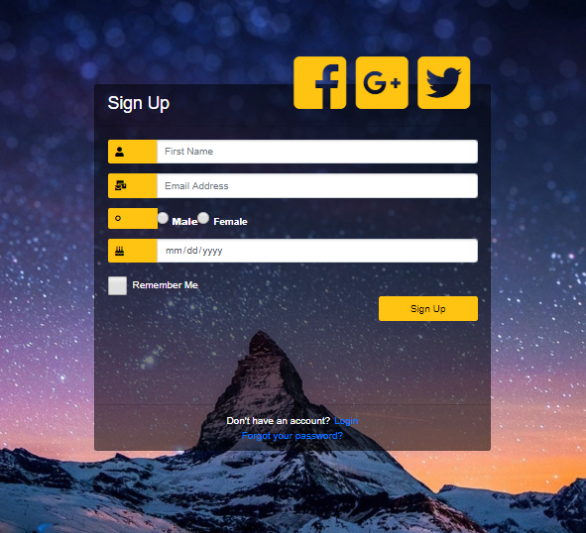
Graphical Interface for Login Admin, Staff and member

Slide 11
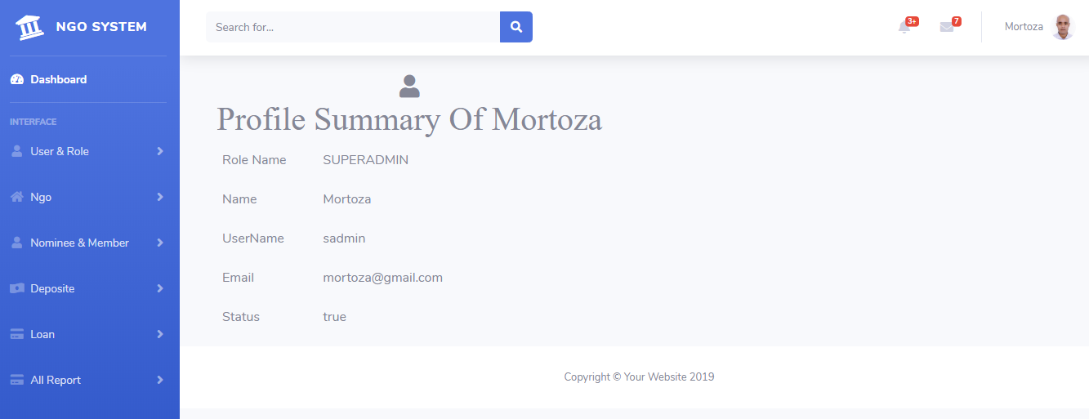
This is Profile For Admin , Which People are engaged to higher Authority and logged in this System

Slide 12
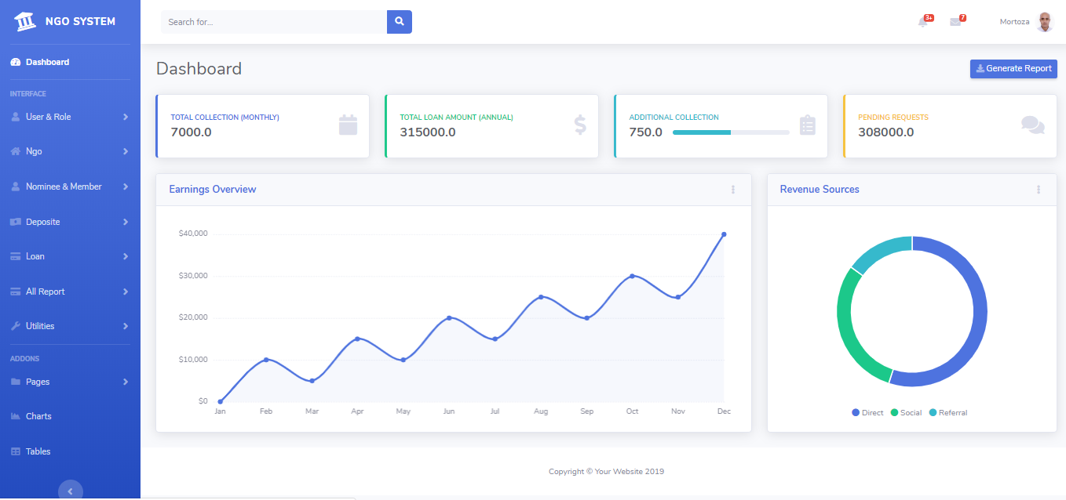
This is Dashboard For Admin , Which People are engaged to higher Authority

Slide 13
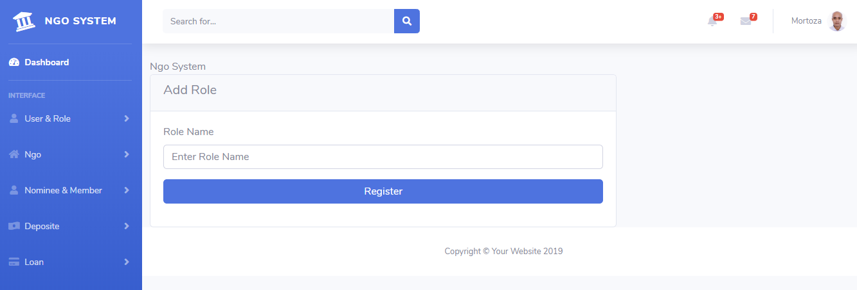
Role Details Form: When we add a user then instantly add database and show data into the table.

Slide 14
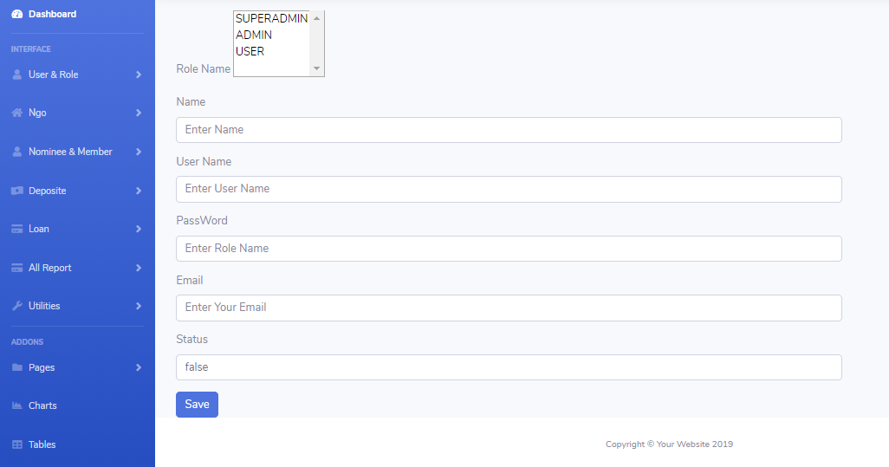
User Details Form: When we add a user then instantly add database and show data inside into the table.

Slide 15
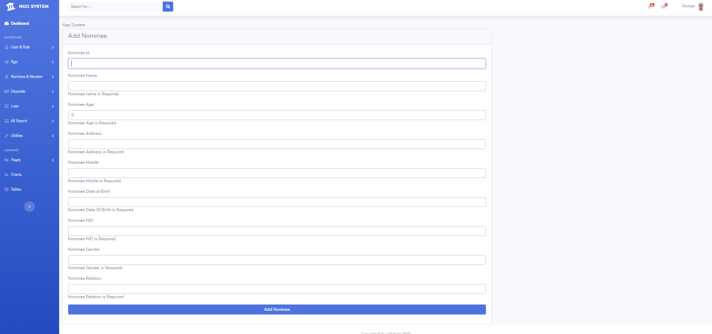
Nominee Details Form: When we add a user then instantly add database and show data inside into the table.

Slide 16
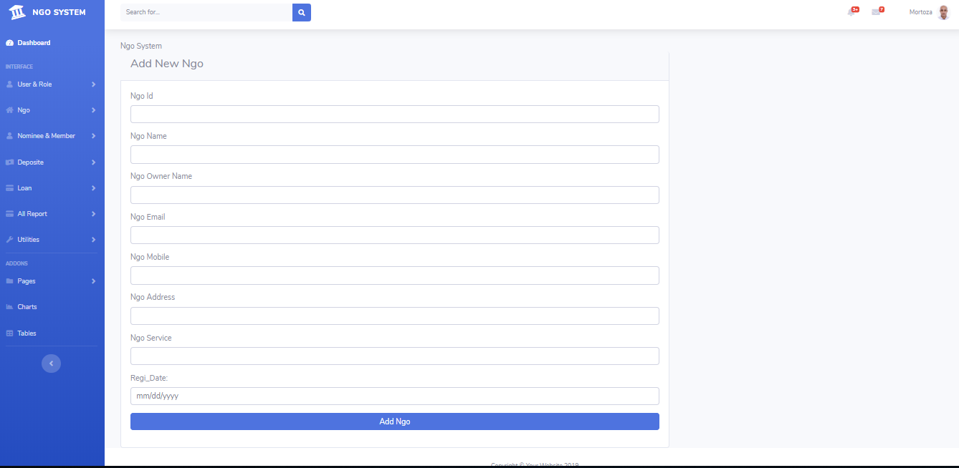
Ngo Details Form: When we add a user then instantly add database and show data inside into the table.

Slide 17
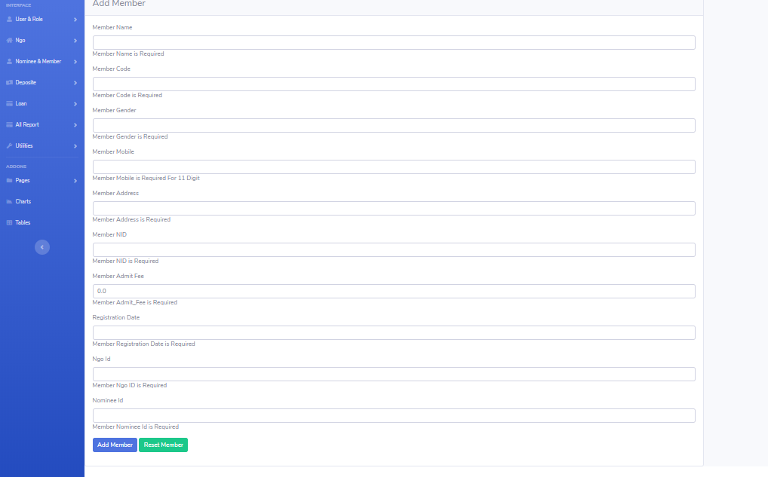
Member Details Form: When we add a user then instantly add database and show data inside into the table.

Slide 18
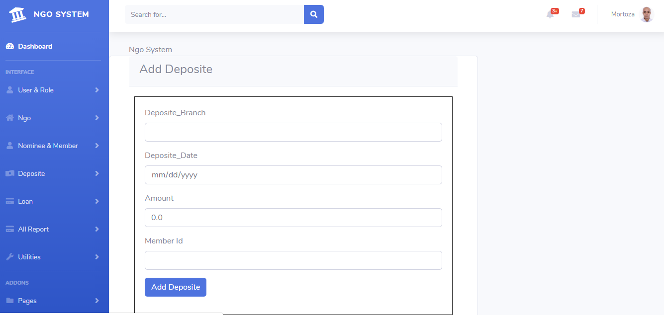
Deposit Details Form: When we add a user then instantly add database and show data inside into the table.

Slide 19
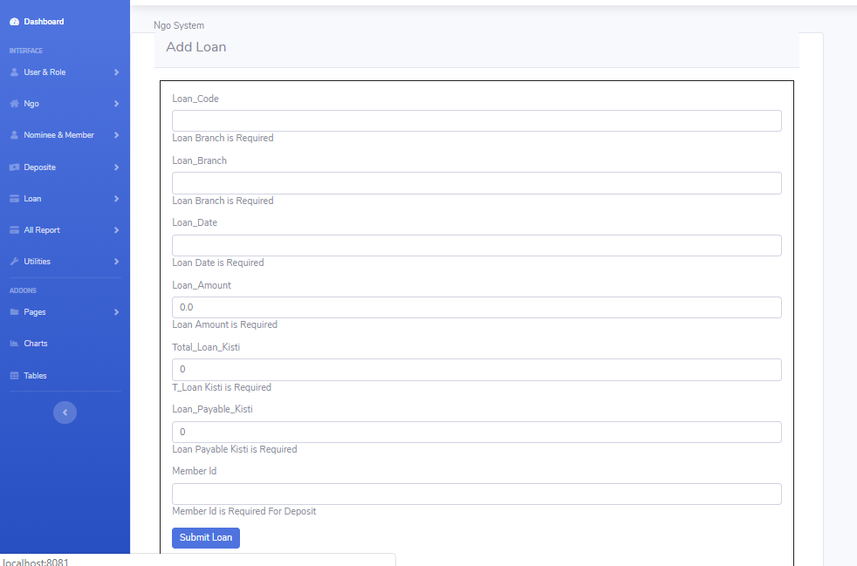
Loan Details Form: When we add a user then instantly add database and show data inside into the table.

Slide 20
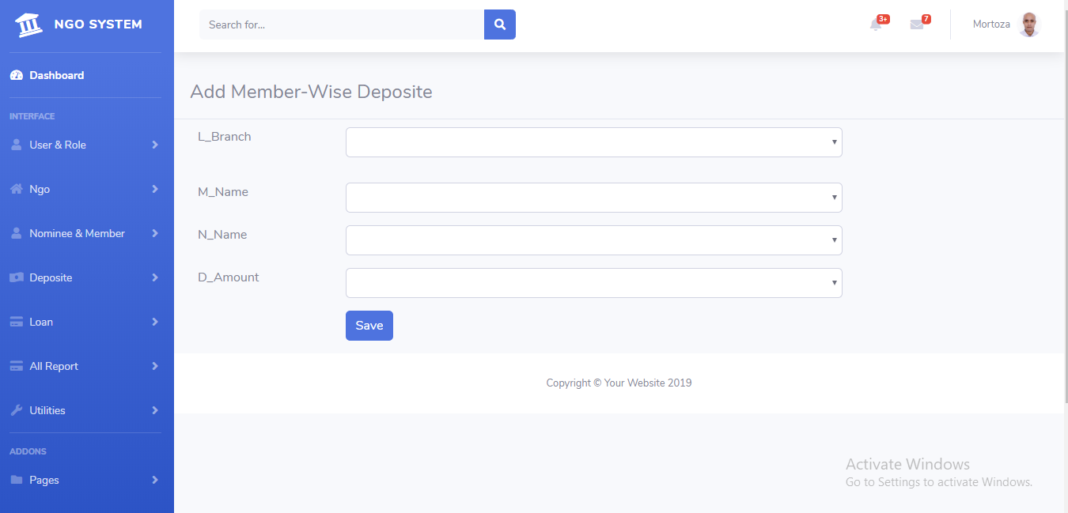
Member-Wise Deposit Form: When we add a user then instantly add database and show data inside into the table.

Slide 21
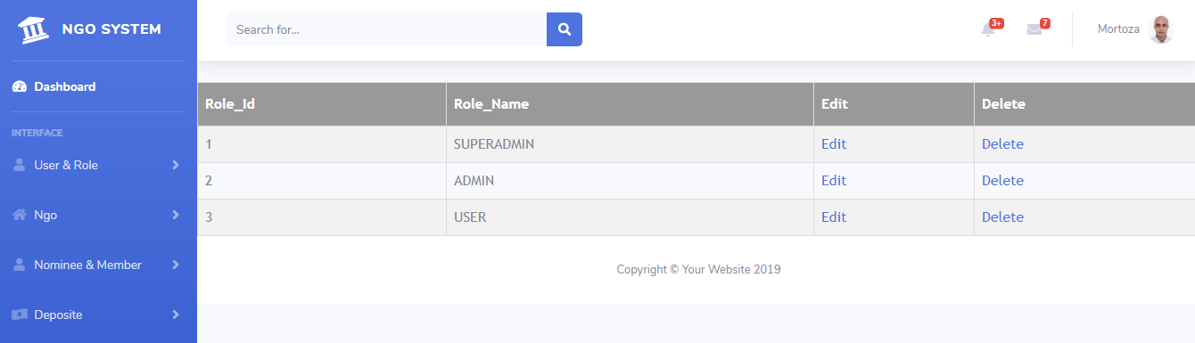
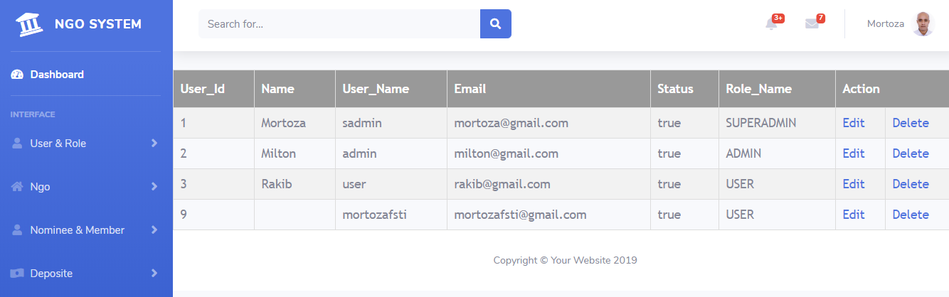
Role And User Data Details With Sample Data

Slide 22
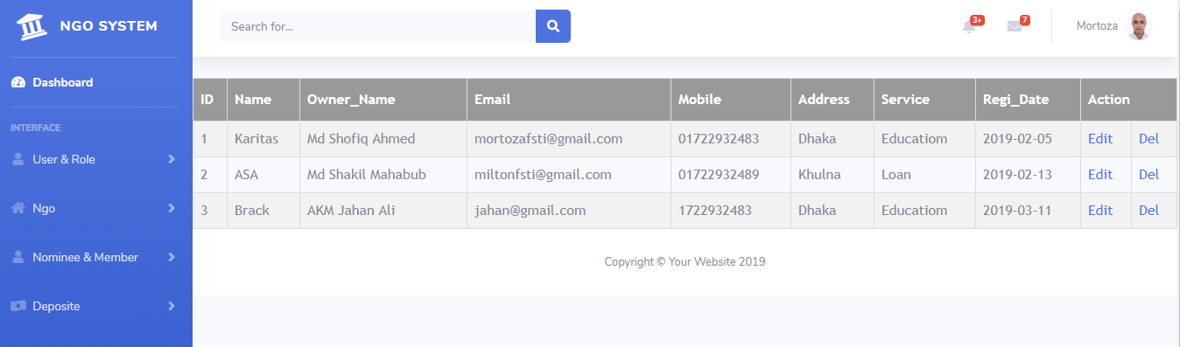
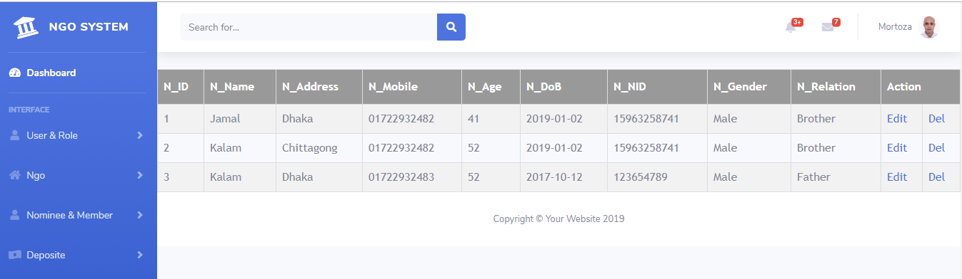
Ngo And Nominee Data Details With Sample Data

Slide 23
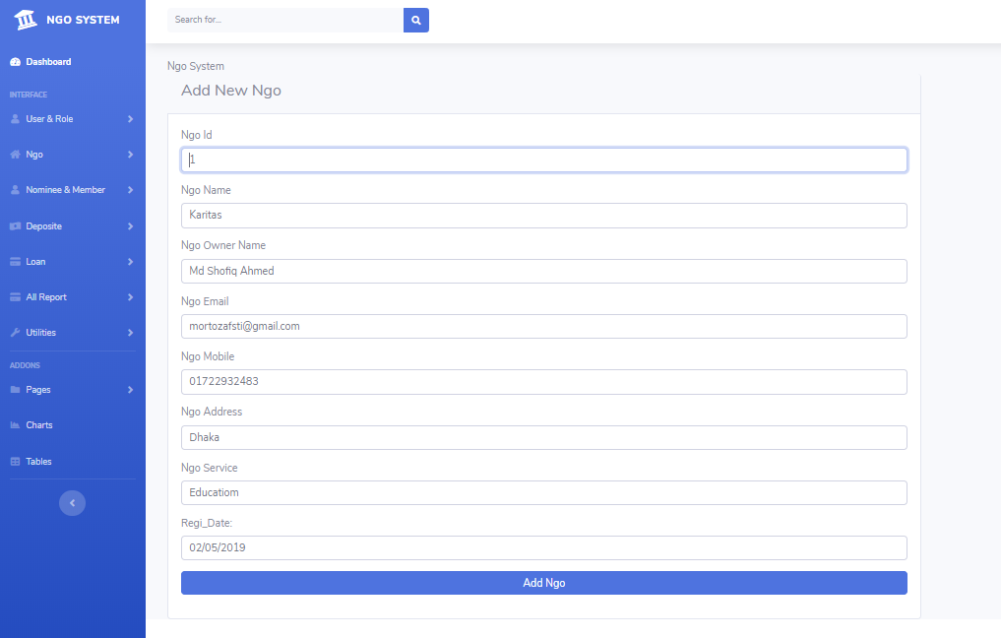
Edit Ngo And Nominee Data Details With Sample Data

Slide 24
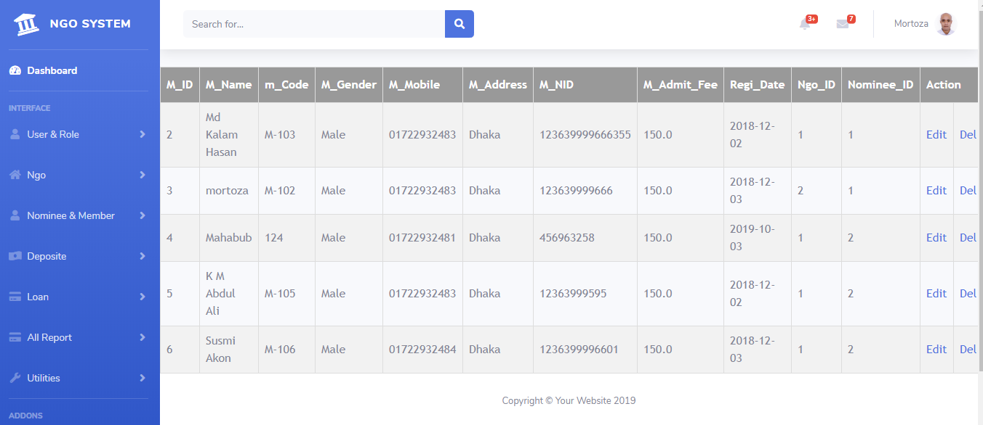
Member Data Details With Sample Data

Slide 25
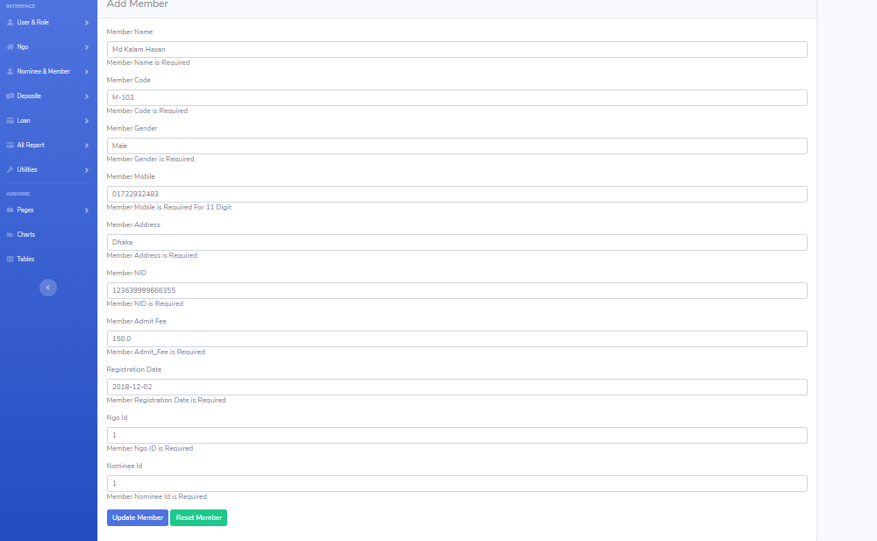
Edit Member Data Details With Sample Data

Slide 26
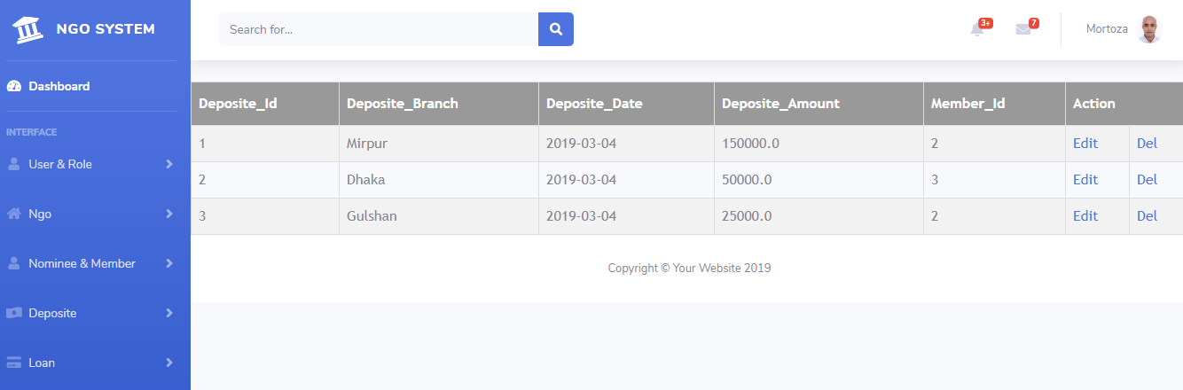
Deposit Data Details With Sample Data

Slide 27
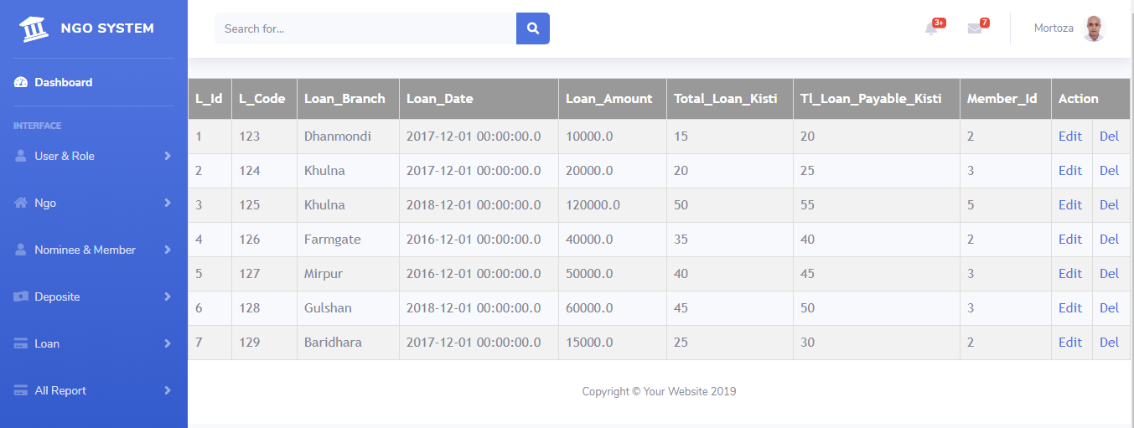
Loan Data Details With Sample Data

Slide 28
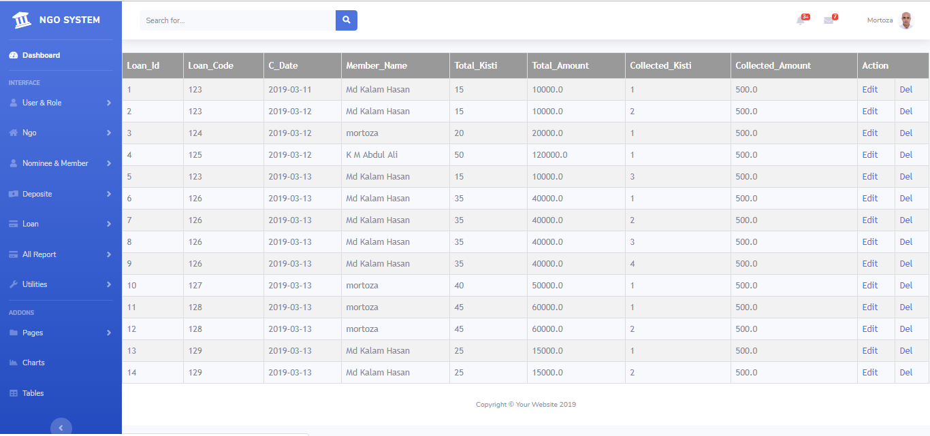
Collection Data Details With Sample Data

Slide 29
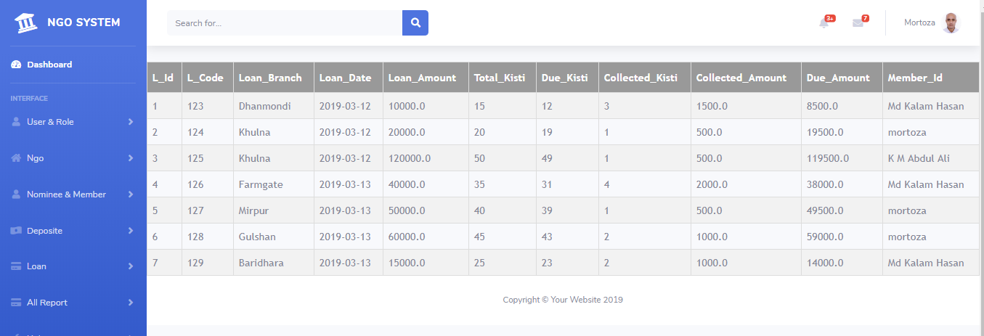
Report Data Details With Sample Data

Slide 30
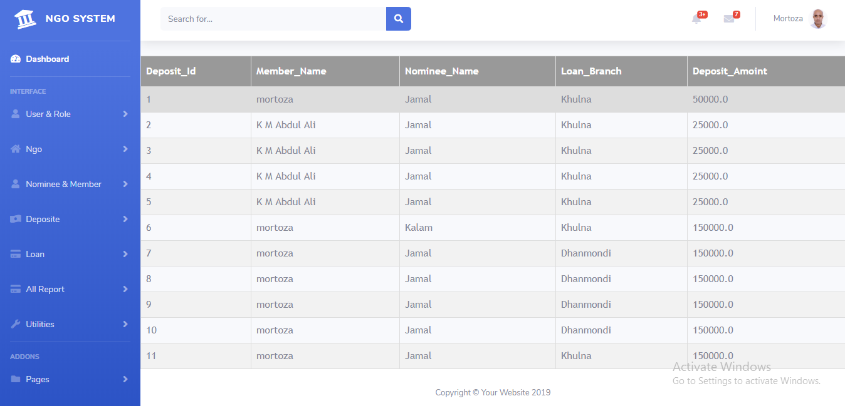
Member-Wise Report Data Details With Sample Data

Slide 31
This is Dashboard For Admin , Which People are engaged to higher Authority

Slide 32
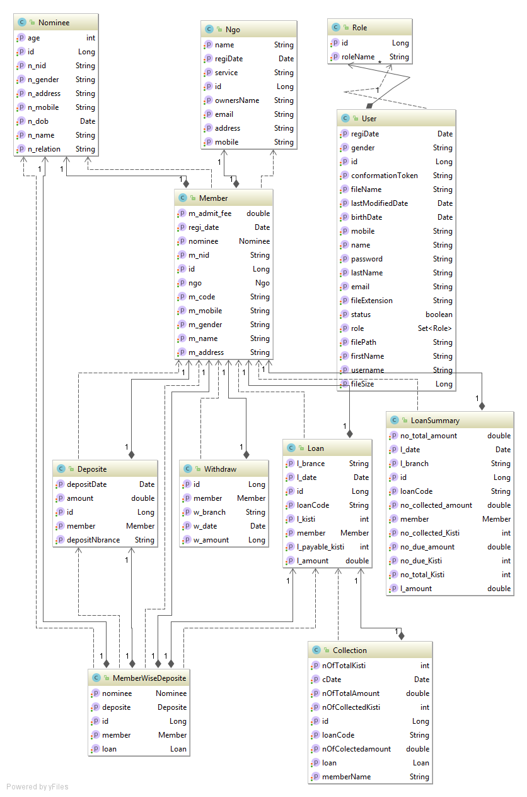
Entity Relationship Diagram

Slide 33
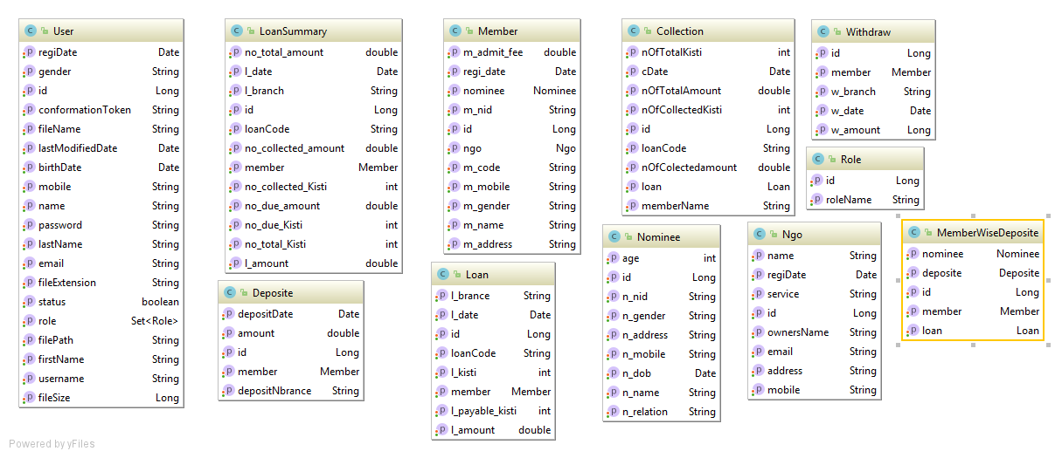
Entity Diagram

Slide 34
Thank You
Sir For Visit this Site

